Slide 1
Exploratory Data Analysis and Model Proposal
Data Science:: Healthcare - Persistency of a drug
Krishna Ratna Deepika Haripuram December 11^{th,} 2023

Slide 2

Problem Statement Approach
Agenda
EDA
EDA Recommendations
Model Proposal

Slide 3
Data Science:: Healthcare - Persistency of a drug
Objective: Analyze healthcare dataset to understand drug persistency as prescribed by physicians.
Target Variable: 'Persistency_Flag' indicating medication adherence.
Key Goal: Identify factors influencing drug persistency.
Model Development: Build a predictive model to classify patients based on their adherence.
Significance: Enhance patient care, optimize treatment strategies.
Impact: Assist pharmaceutical companies in informed decision-making regarding patient treatment plans and healthcare policies.
Krishna Ratna Deepika Haripuram December 11^{th,} 2023
Problem Statement

Slide 4
Dataset Overview:
Provided File: 'Healthcare_dataset.xlsx'.
Comprises data of 3,424 patients.
Includes demographics, clinical records, risk factors, and physician specialty details.
Data Analysis Strategy:
Comprehensive Variable Analysis: Conducted on the entire dataset to understand each variable's impact.
Focus on Demographic and Clinical Variables: Examined to uncover patterns and correlations.
Exploratory Data Analysis (EDA):
Holistic Data Examination: EDA performed on the complete dataset for in-depth insights.
Goal: Identify significant trends and factors influencing drug persistency.
Model Development:
Developed a Predictive Model: Aimed at classifying patients based on 'Persistency_Flag'.
Utilized Advanced Analytics Techniques: To predict medication adherence and identify key influencing factors.
Approach

Slide 5
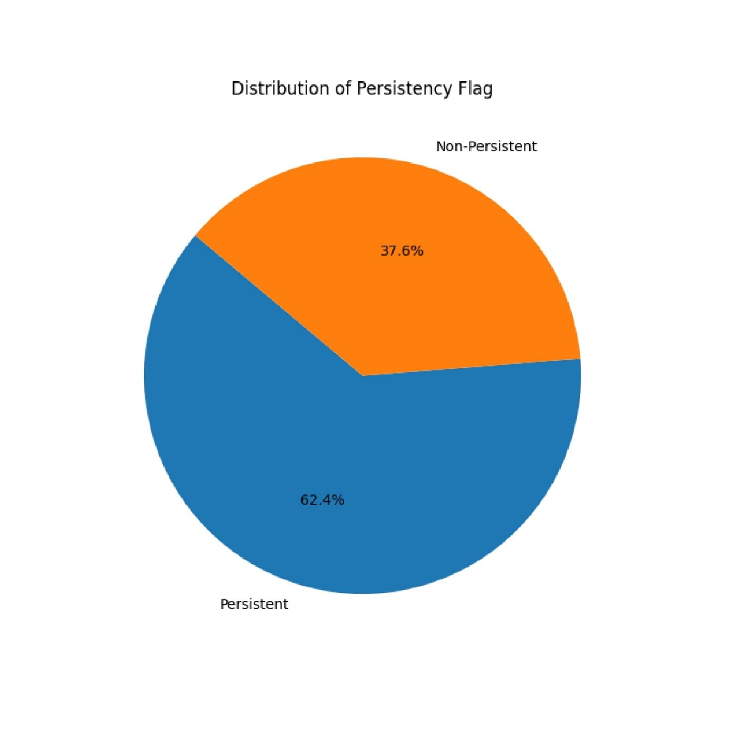
Distribution of Persistency Flag
The pie chart depicts the overall distribution of the persistency flag among patients.
A significant majority show persistence, but there remains a considerable portion that is non-persistent, highlighting the need for targeted interventions.

Slide 6
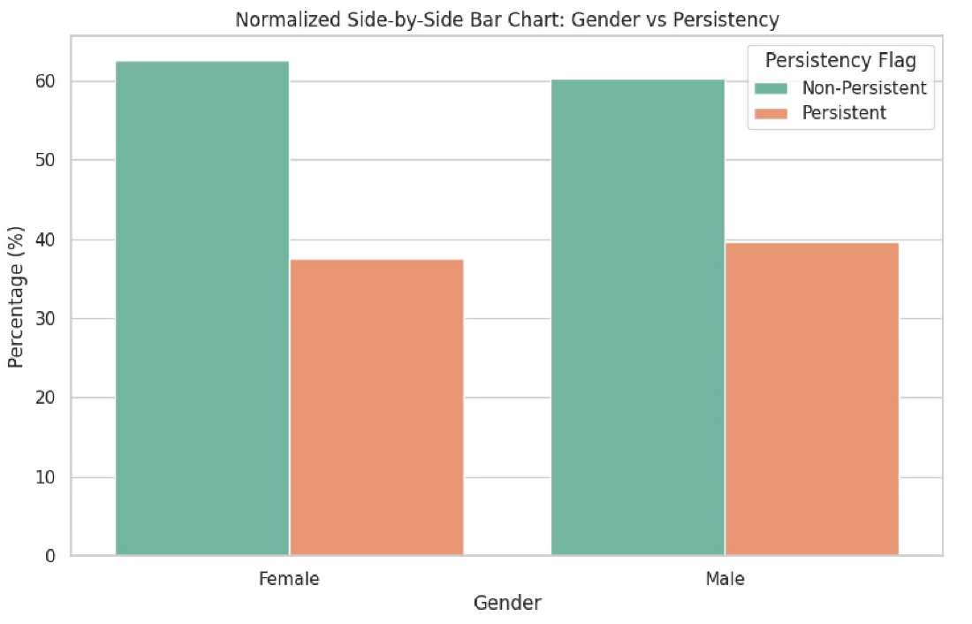
Gender vs Persistency
This normalized bar chart compares drug persistency rates between genders.
While there are slight differences, both genders show substantial non-persistent populations, indicating a need for gender-specific adherence strategies.

Slide 7
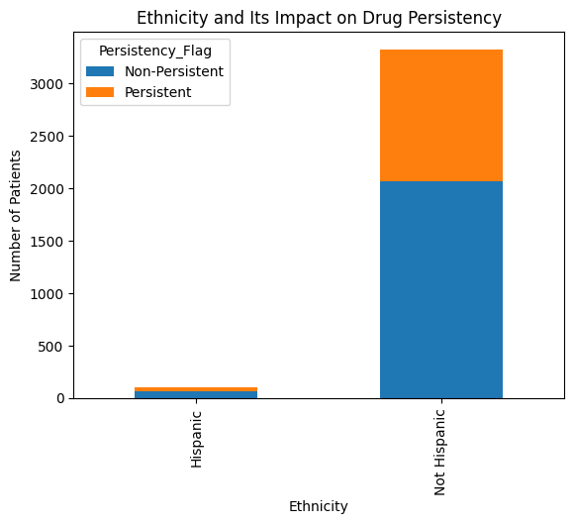
Ethnicity and Its Impact on Drug Persistency
The bar chart explores how ethnicity affects drug persistency, with notable differences between ethnic groups.
Understanding cultural and social factors could be key to improving patient-specific treatment plans.

Slide 8
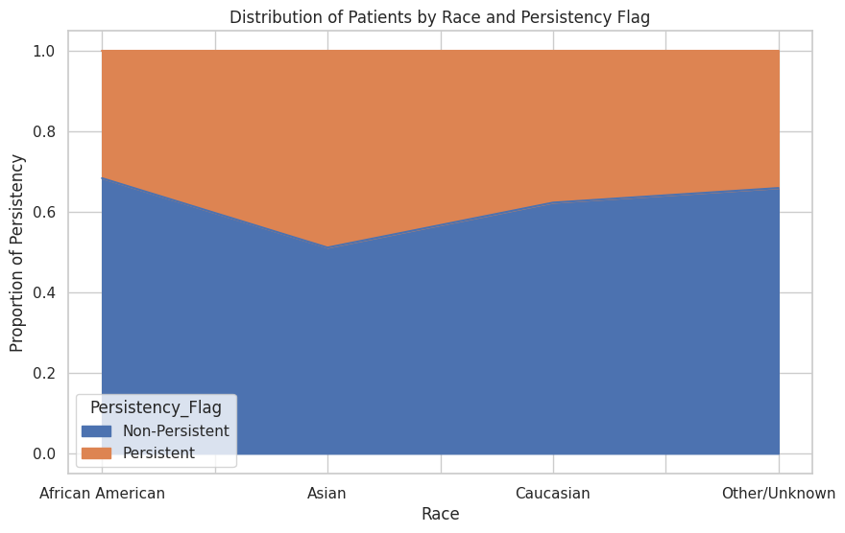
Distribution of Patients by Race and Persistency Flag
This stacked bar chart provides insight into drug persistency rates across different races.
The proportion of persistency within each racial group highlights potential disparities that could be addressed to improve medication adherence.

Slide 9
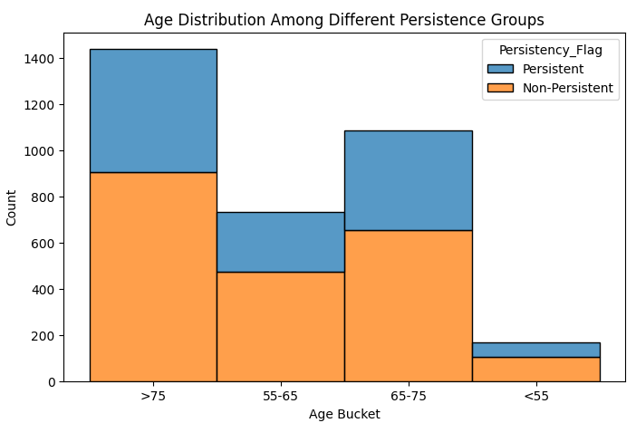
Age Distribution Among Different Persistence Groups
The bar chart compares the age distribution between persistent and non-persistent patients.
It reveals that persistence does not significantly differ across age groups, suggesting that other factors may play more critical roles in persistency.

Slide 10

Specialties of Healthcare Providers (Word Cloud)
The word cloud visually represents the various healthcare provider specialties, with the size of each term indicating its frequency.
General practice, surgery, and oncology are prominently featured, which could be influential in-patient drug persistency.

Slide 11
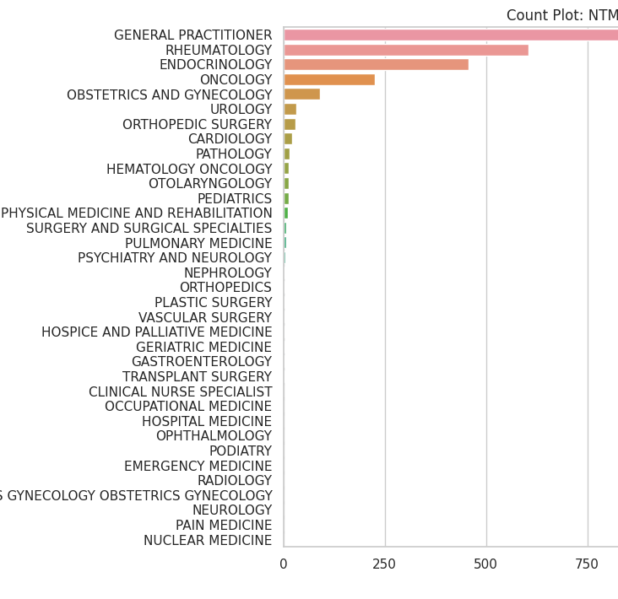
NTM Physician Specialty Distribution
The bar chart showcases the distribution of NTM physician specialties.
General practitioners are the most common, followed by rheumatologists and endocrinologists, indicating these specialties' roles in ongoing patient care and potentially influencing drug persistency.

Slide 12
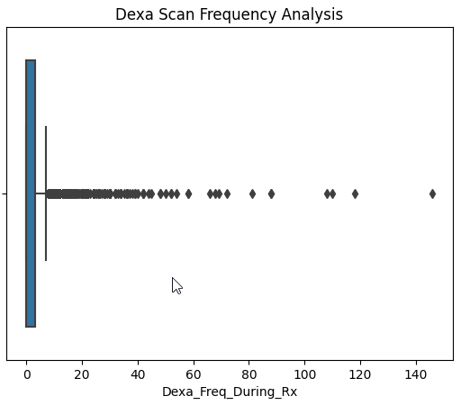
Dexa Scan Frequency Analysis
Boxplot displays the overall distribution of Dexa scan frequencies among all patients, showing a wide range but with most patients undergoing few scans, which may impact their treatment persistency.
It helps identify common ranges and outliers in scan frequencies, which can be critical in assessing patient engagement with their treatment plans.

Slide 13
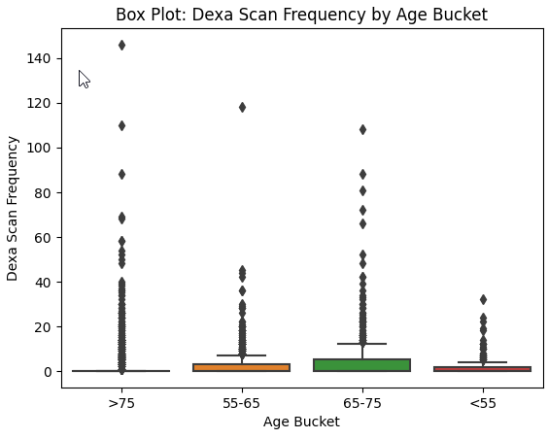
Dexa Scan Frequency by Age Bucket
The boxplot categorizes patients by age and the frequency of Dexa scans they received.
The data indicates that older patients (>75) are more likely to have frequent Dexa scans, which could be attributed to increased monitoring with advancing age.

Slide 14
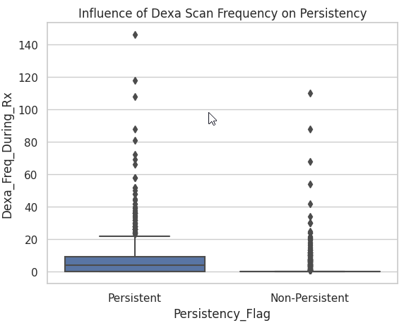
Influence of Dexa Scan Frequency on Persistency
This boxplot illustrates the distribution of Dexa scan frequencies among patients, categorized by their drug persistency status.
Notably, persistent patients tend to undergo Dexa scans more frequently, which may suggest a correlation between regular monitoring and medication adherence.

Slide 15
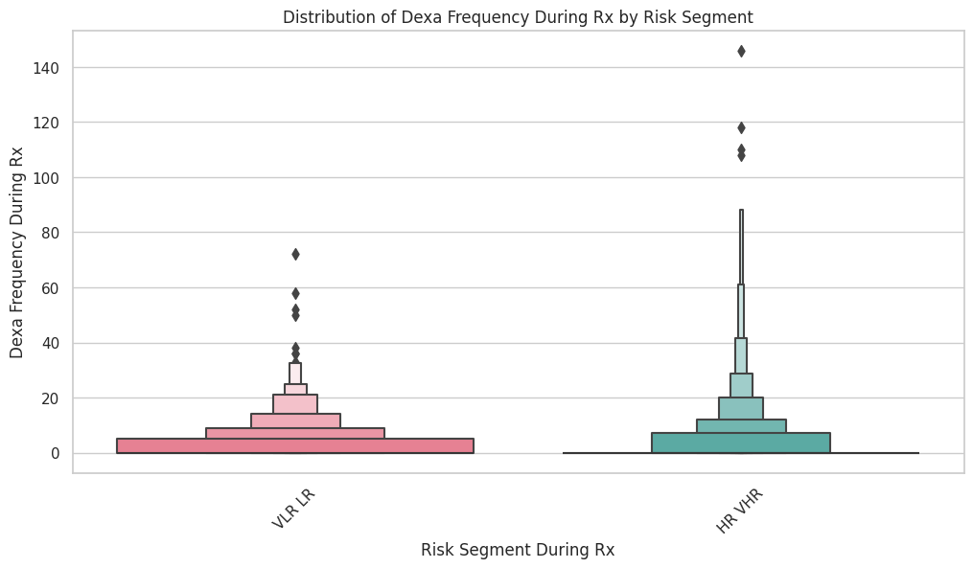
Distribution of Dexa Frequency During Rx by Risk Segment
This boxen plot compares the frequency of Dexa scans during treatment across different risk segments, suggesting that patients with a higher risk profile receive more frequent monitoring.

Slide 16
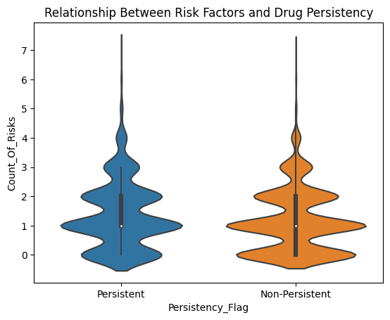
Relationship Between Risk Factors and Drug Persistency
The violin plot examines the relationship between the number of risk factors and drug persistency.
A higher number of risk factors is associated with increased persistency, possibly due to more intensive health monitoring.

Slide 17
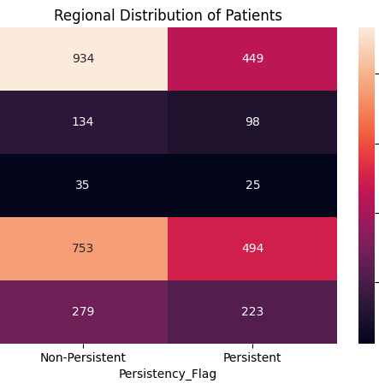
Regional Distribution of Patients
The heatmap visualizes patient distribution and drug persistency by region, offering insights into regional adherence patterns that could be vital for localized healthcare strategies.

Slide 18
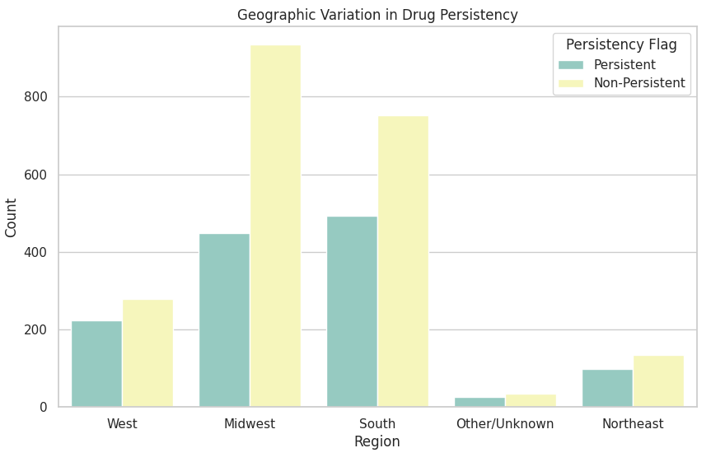
Geographic Variation in Drug Persistency
This chart presents the geographic variation in drug persistency, with certain regions showing higher rates of non-persistence, which could inform regional healthcare policy and patient outreach efforts.

Slide 19
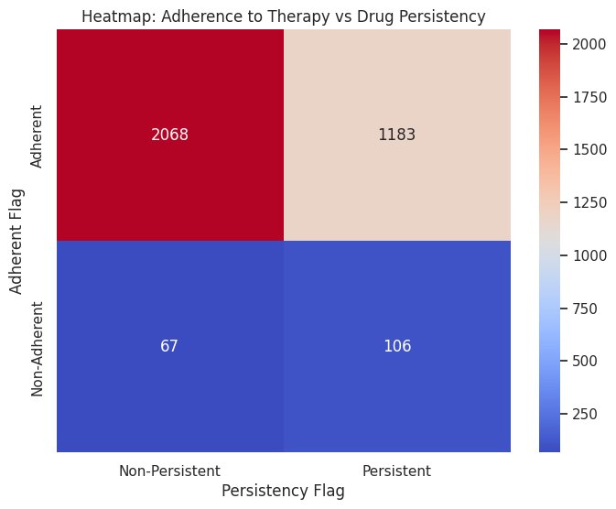
Heatmap: Adherence to Therapy vs Drug Persistency
The heatmap compares therapy adherence to drug persistency, indicating that patients who adhere to their therapy schedule are generally more persistent with their medication.

Slide 20
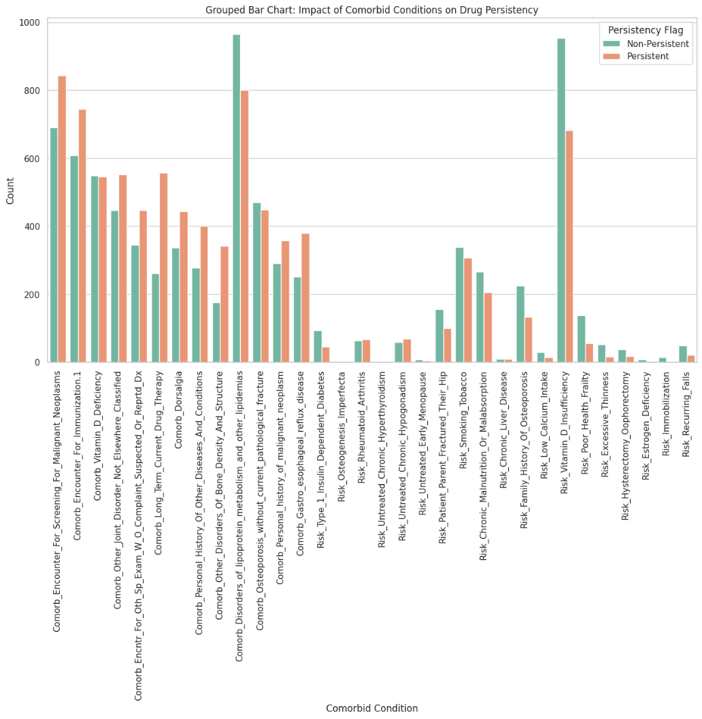
Impact of Comorbid Conditions on Drug Persistency
This chart analyzes the effects of comorbid conditions on drug persistency.
Certain conditions, such as chronic pain and hypertension, show a clear correlation with higher rates of persistency, likely due to the necessity of consistent treatment.

Slide 21
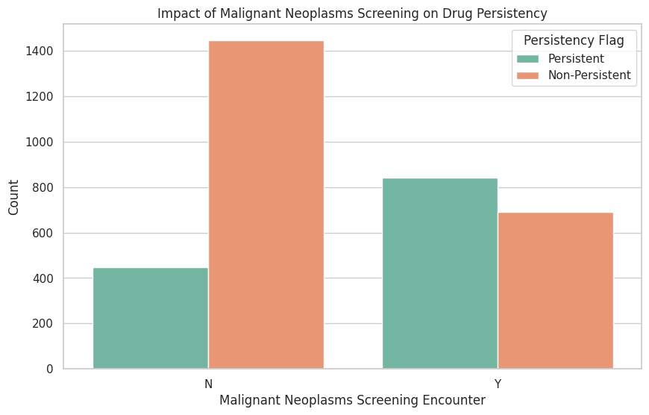
Impact of Malignant Neoplasms Screening on Drug Persistency
The bar chart demonstrates the impact of malignant neoplasms screening on drug persistency.
Patients screened for neoplasms tend to be more persistent, possibly due to increased engagement with healthcare services.

Slide 22
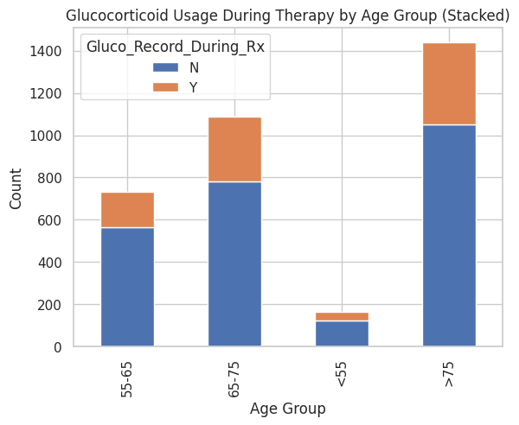
Glucocorticoid Usage During Therapy by Age Group
This stacked bar chart shows glucocorticoid usage during therapy across different age groups.
Older patients have higher usage, which may influence persistency due to the chronic nature of conditions treated with glucocorticoids.

Slide 23
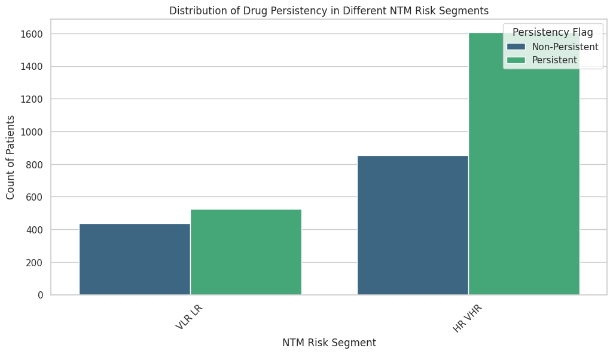
Distribution of Drug Persistency in Different NTM Risk Segments
This bar chart illustrates the distribution of drug persistency within NTM risk segments.
Patients in the higher risk segments show increased persistency, suggesting that risk awareness may motivate adherence to treatment.

Slide 24

EDA Recommendations
Personalized Patient Education: Develop individualized education programs that account for a patient's medical history, understanding level, and personal preferences to enhance medication adherence.
2. Regular Health Monitoring: Implement routine health monitoring using digital tools and in-person check-ups to track patient progress and adjust treatments as necessary.
3. Targeted Interventions: Create intervention strategies for patients with specific comorbid conditions and within demographic groups that are statistically less likely to adhere to prescribed medications.
4. Cross-Disciplinary Communication: Foster better communication between general practitioners and specialists to ensure a cohesive treatment approach, and address disparities in drug persistency across different races and regions.

Slide 25
Model Proposals for Predicting Drug Persistency
1. Support Vector Machines (SVM):
Utilizes a linear kernel to handle the binary classification of patient persistency.
Suitable for the dataset with high dimensionality, aiming to maximize the margin between classes.
2. Random Forest:
Employs 1000 trees with a maximum depth of 10, balancing the model complexity and prediction accuracy.
Incorporates ensemble learning to improve prediction robustness and manage feature diversity.
3. Decision Tree:
Simplifies the decision-making process with a max depth of 1, providing a fast and interpretable model.
Acts as a baseline to understand the primary splits affecting persistency.
4. Logistic Regression:
Applies a binary logistic regression model optimized with GridSearchCV, perfect for probability estimation.
Leverages one-hot encoding to transform categorical variables, enhancing model accuracy.
These models offer a range from simple to complex approaches, balancing interpretability and predictive power for drug persistency in healthcare data.

Slide 26

Thank You

